Slide 1
Effects of Noise on Expectation Value (2) + Readout Error Mitigation
Results from Halloween Weekend
November 1, 2020

Slide 2
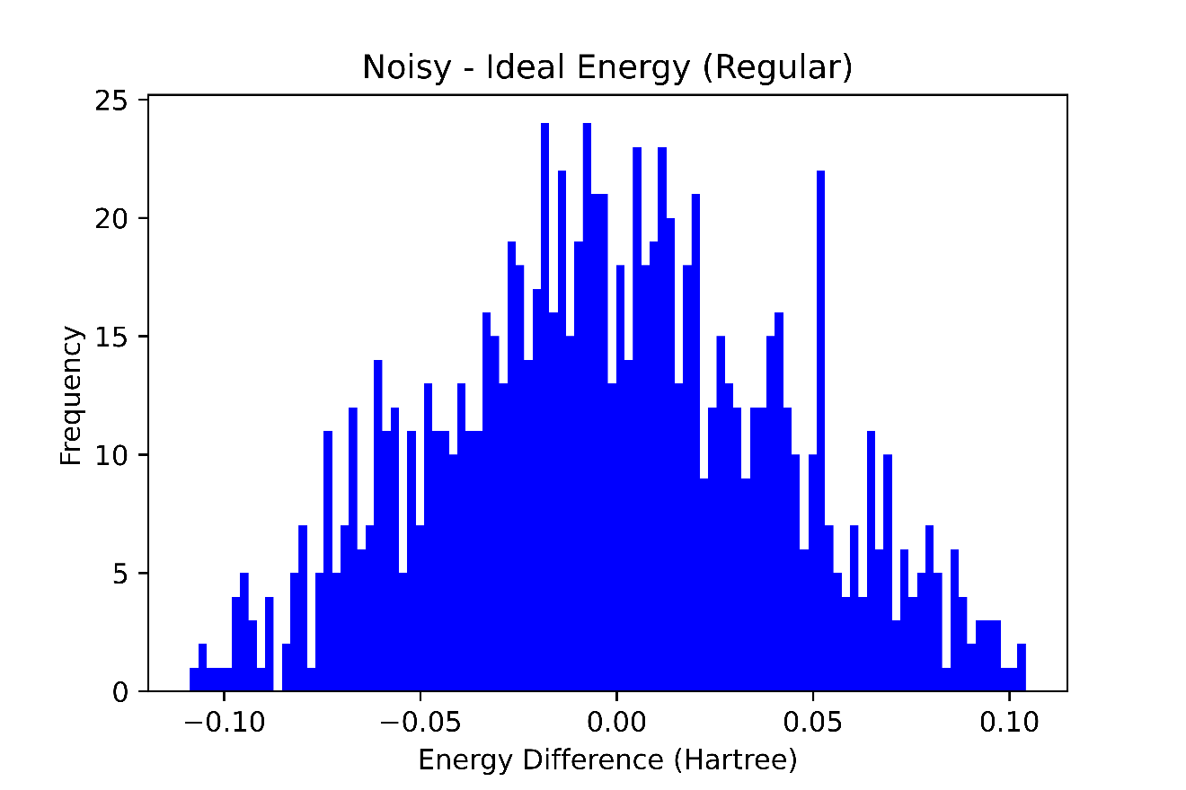
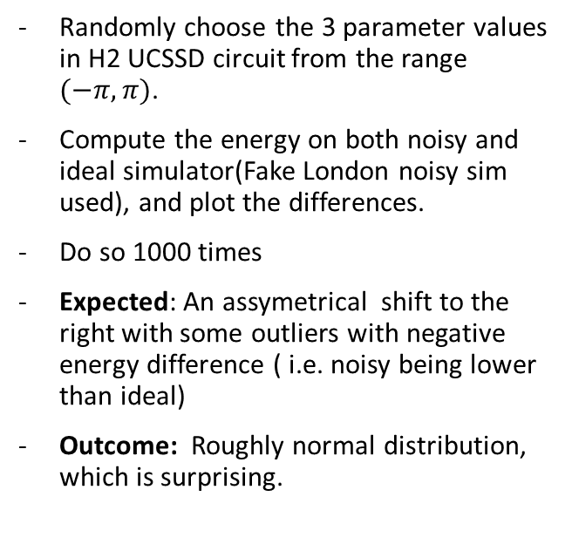
Recap Experiment
Randomly choose the 3 parameter values in H2 UCSSD circuit from the range $(−π, π)$.
Compute the energy on both noisy and ideal simulator(Fake London noisy sim used), and plot the differences.
Do so 1000 times
Expected: An assymetrical shift to the right with some outliers with negative energy difference ( i.e. noisy being lower than ideal)
Outcome: Roughly normal distribution, which is surprising.

Slide 3
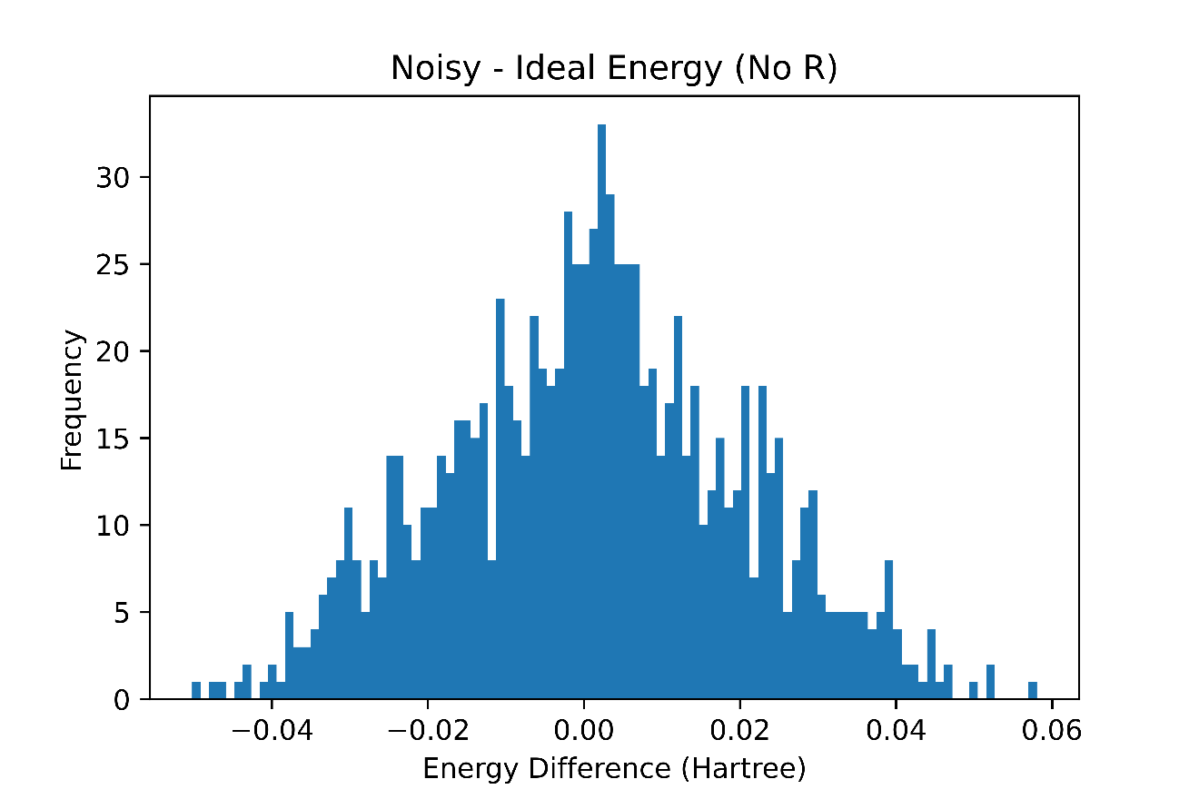
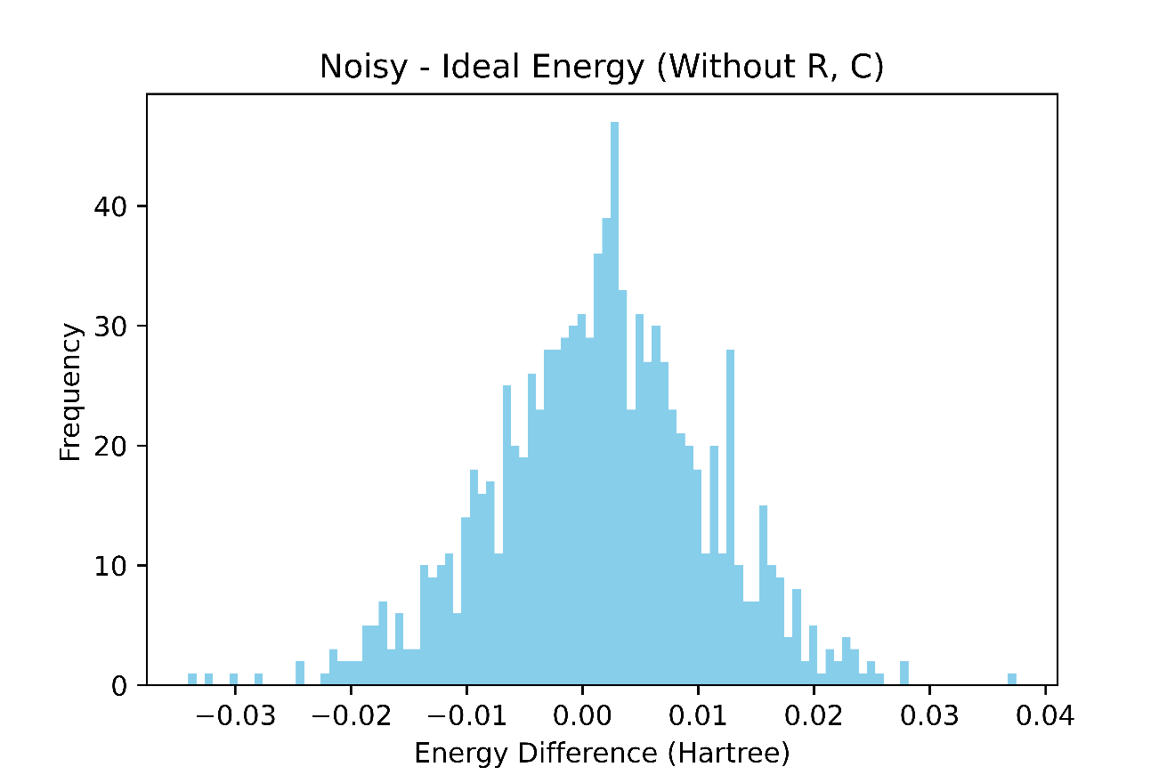
Recap Isolating individual error types
(R) refers to readout errors and (C) refers to coherent errors, (I) refers to incoherent errors.
There seems to be huge change in spread when we remove readout errors – approx. reduction by a factor of 3
In the bottom plot, we expect incoherent errors to have some asymmetrical effect but that is not shown by the plot

Slide 4
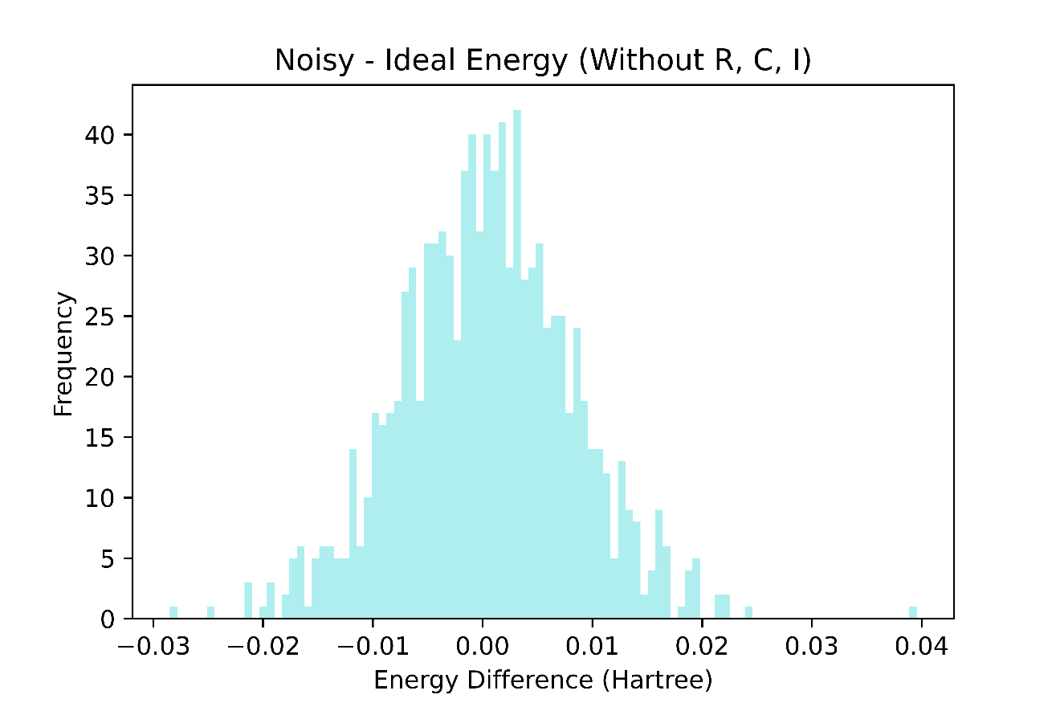
New

Slide 5
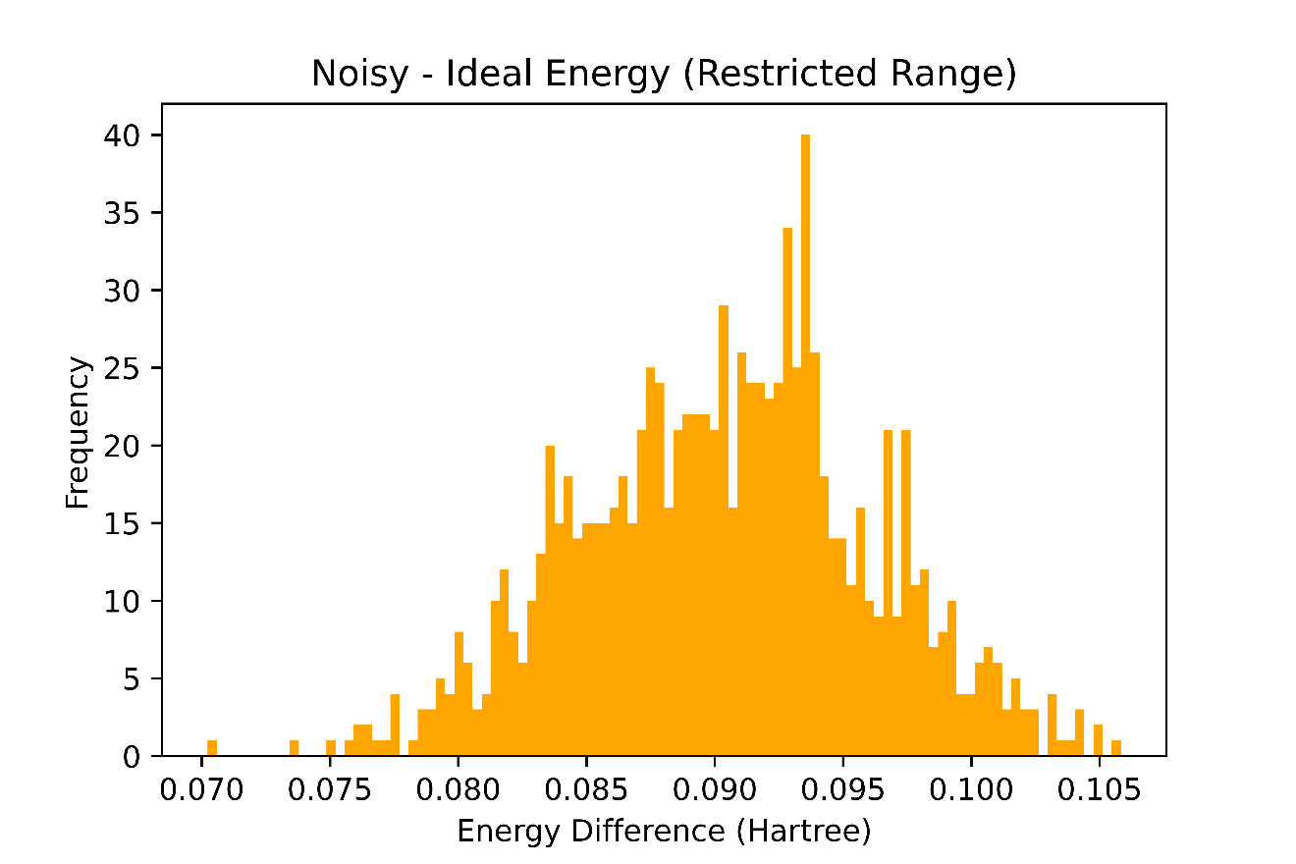
Recap Restricting the Range of parameters about optimized parameters
Obtaining the parameters after VQE finished optimizing (H2 at 0.74 ang sep.) on FakeLondon noisy simulator, we get
[ 0.00172129 -0.00182397 -0.11217598]
So the range for the 3 parameters was restricted to :
[0.0015 +/- 0.0005, -0.0015+/- 0.0005, 0.15+/- 0.05 ] Then sampling parameters from this range, we get the following plot.
Expected: From slide 2, we would expect the same normal distribution centered at 0
Reality: A significant asymmetrical shift to the right.

Slide 6
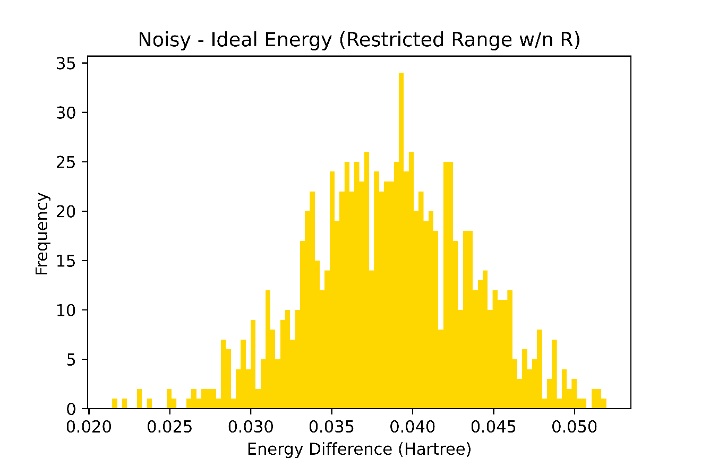
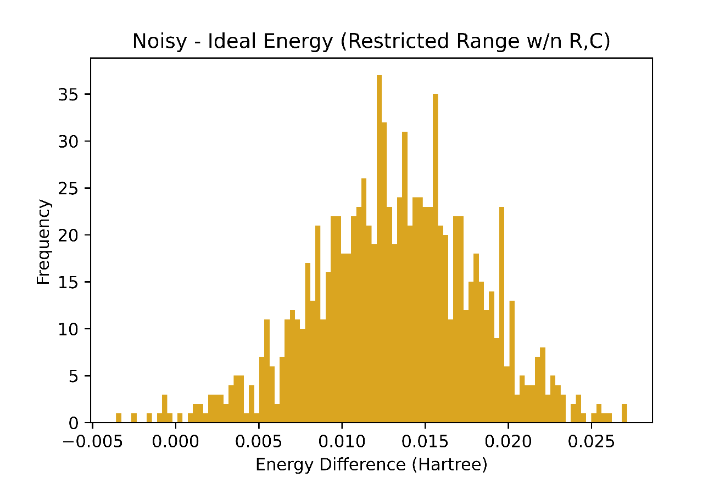
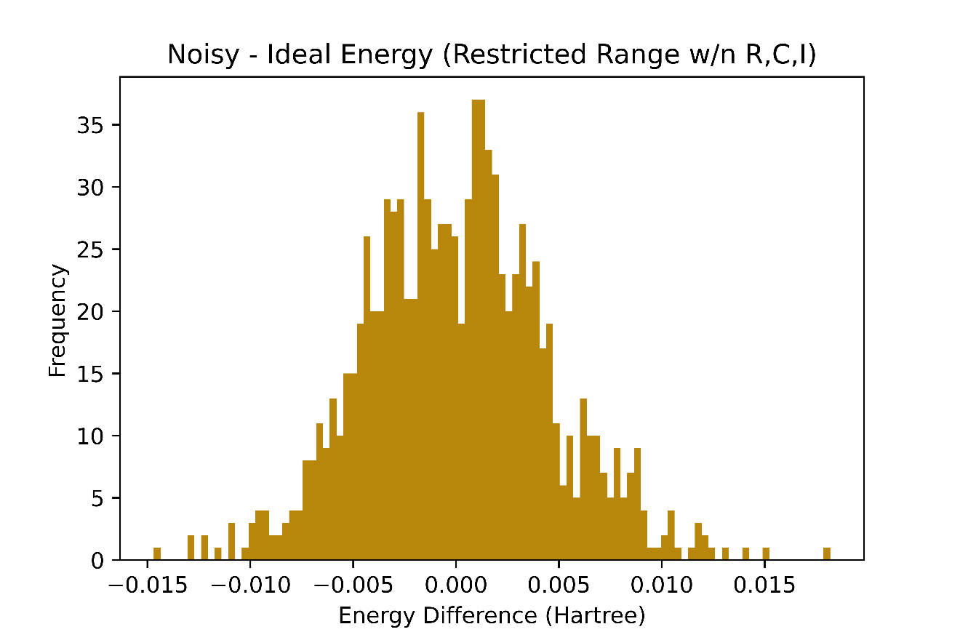
New
New
New

Slide 7
Readout Error Mitigation
Implementing the CNOT method discussed in last week’s meeting on H2 VQE circuit

Slide 8
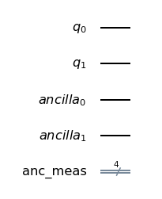
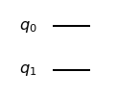
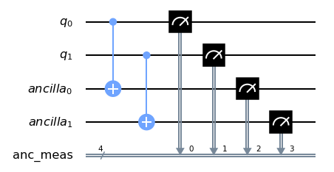
Readout Error Mitigation
Given a circuit, we double the number of qubits and use then entangle the old qubits with the new “ancilla” qubits.
Measuring all the qubits, we reject non-symmetric outcomes i.e. |0001> is rejected because if 1st qubit is in 1 state then third qubit should also be in that state… we will accept |0101>
Testing this method on circuit for VQE Hydrogen molecule.
Conducting same experiments as in Slide 2 and slide 5

Slide 9
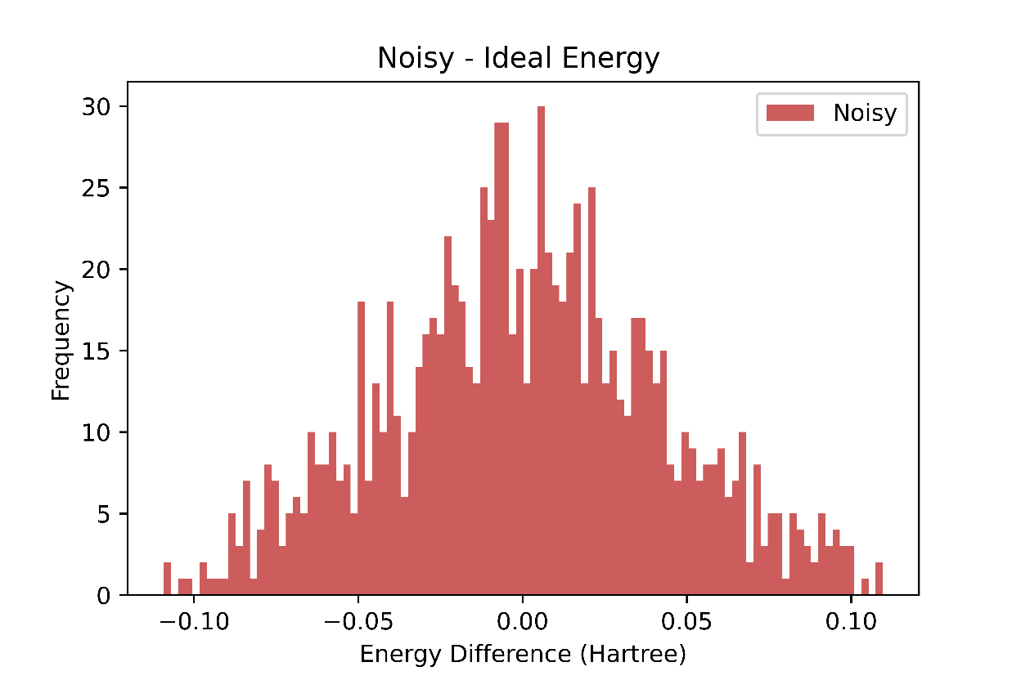
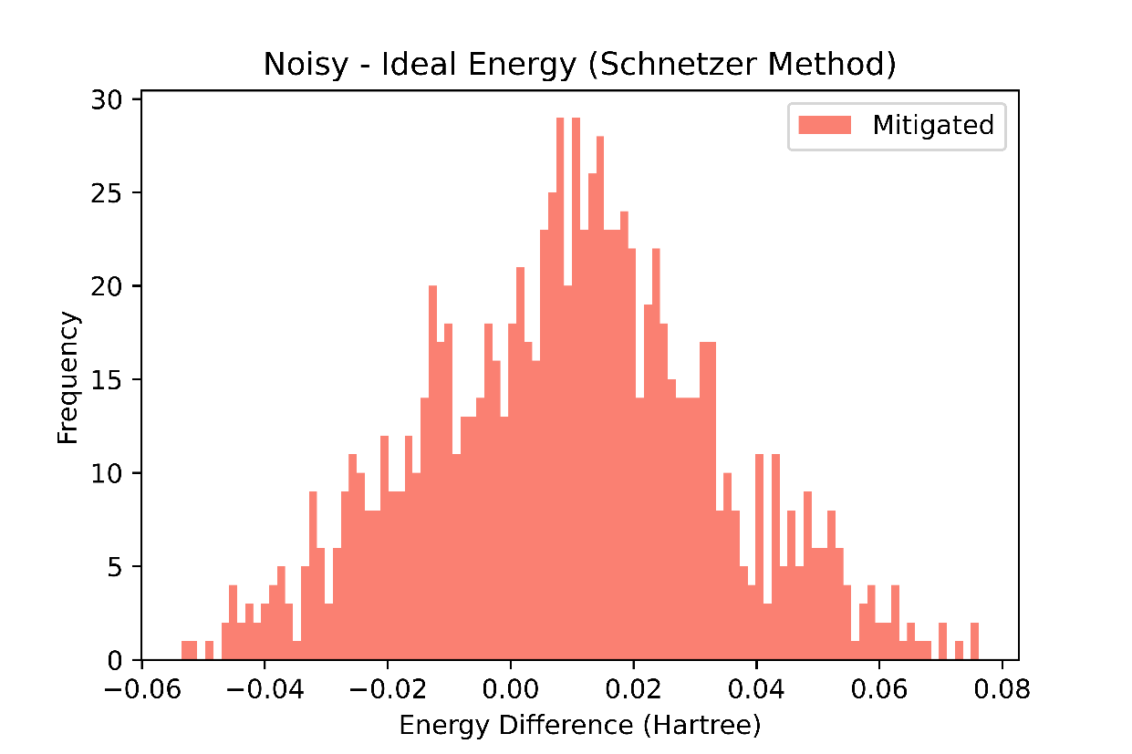
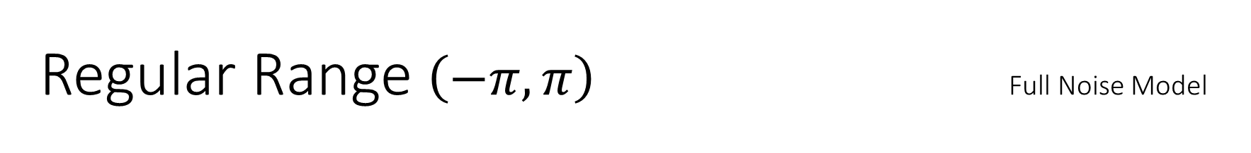
Regular Range $\left(−π, π\right)$ Full Noise Model

Slide 10
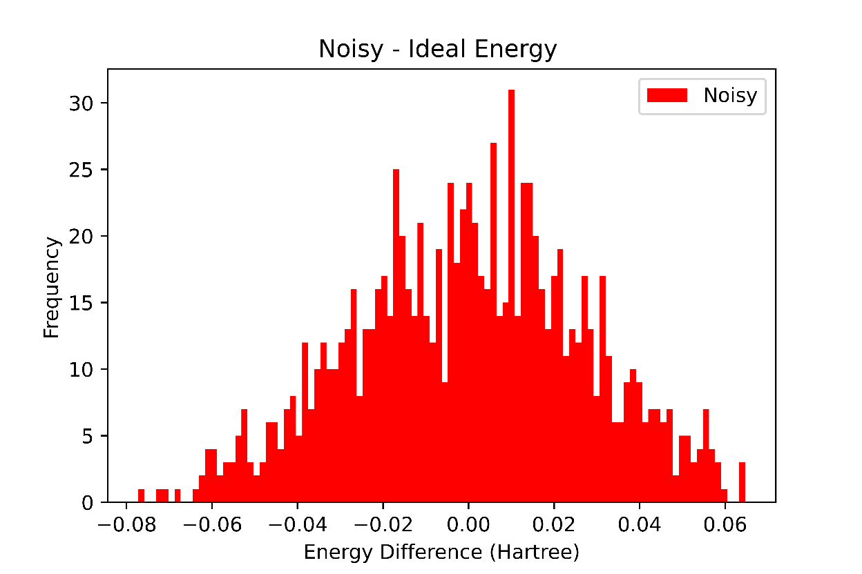
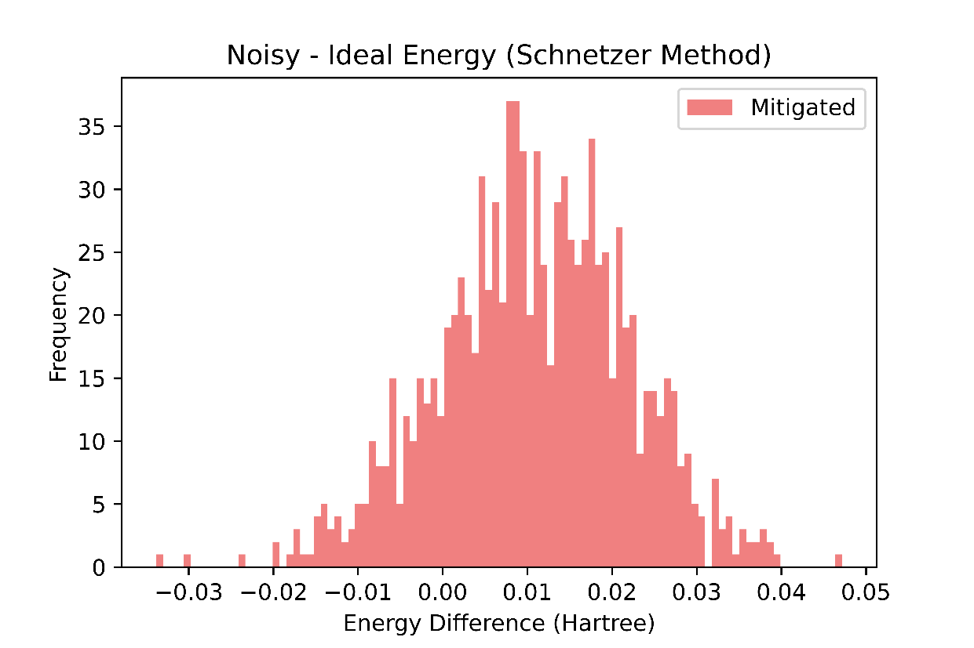
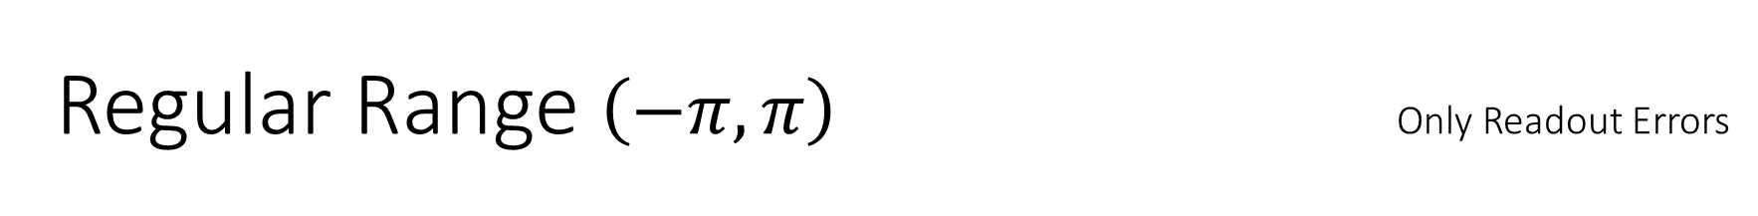
Regular Range $\left(−π, π\right)$ Only Readout Errors

Slide 11
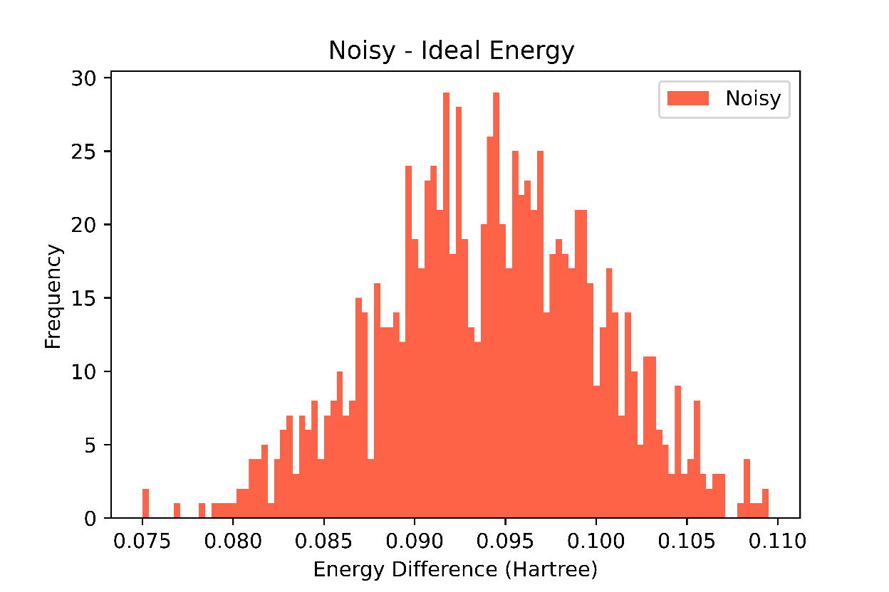
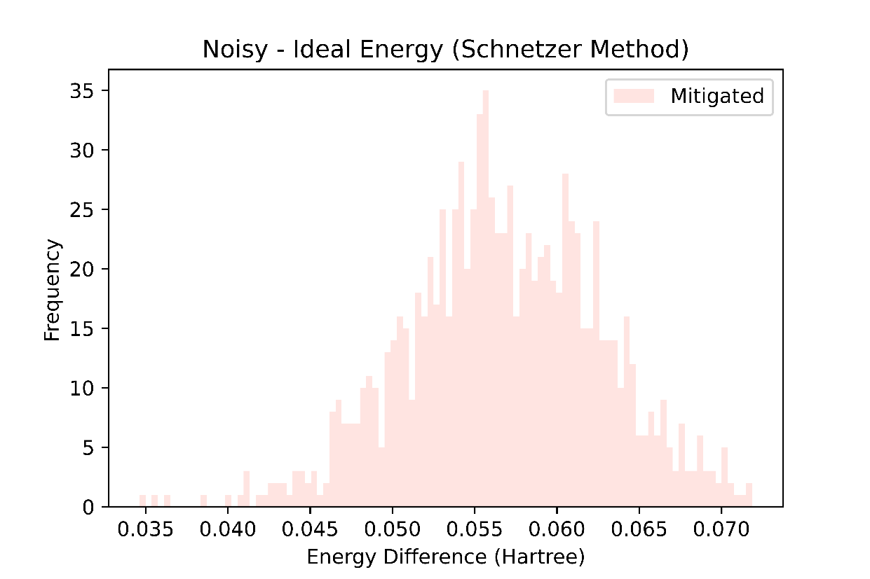
Restricted Range [(0.001, 0.002),(-0.002, -0.001), (-0.2, -0.1)] Full Noise Model

Slide 12
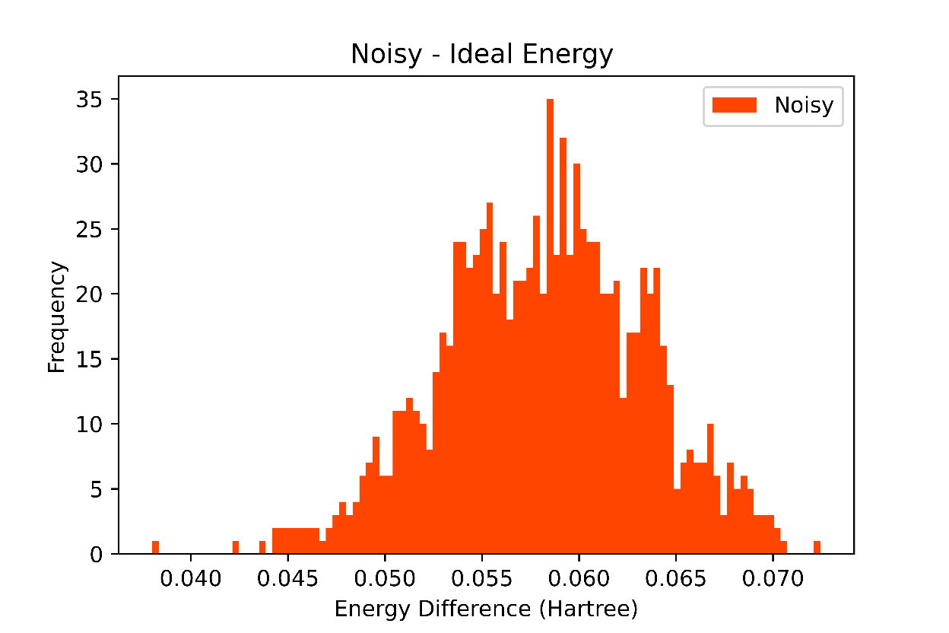
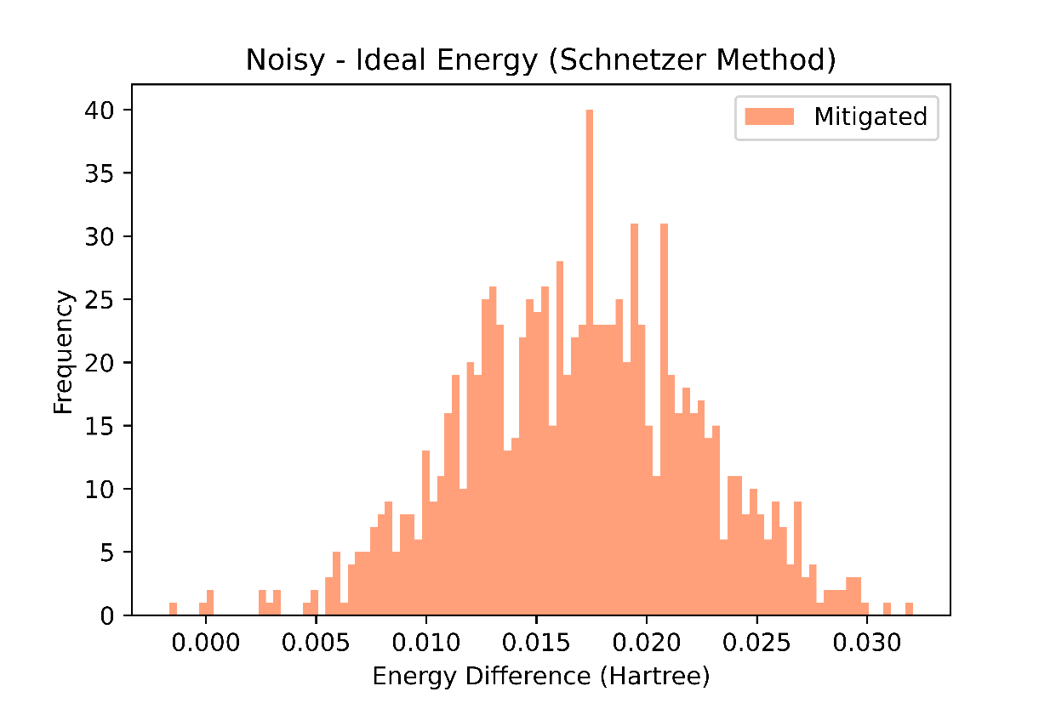
Restricted Range [(0.001, 0.002),(-0.002, -0.001), (-0.2, -0.1)] Only Readout Errors

Slide 13
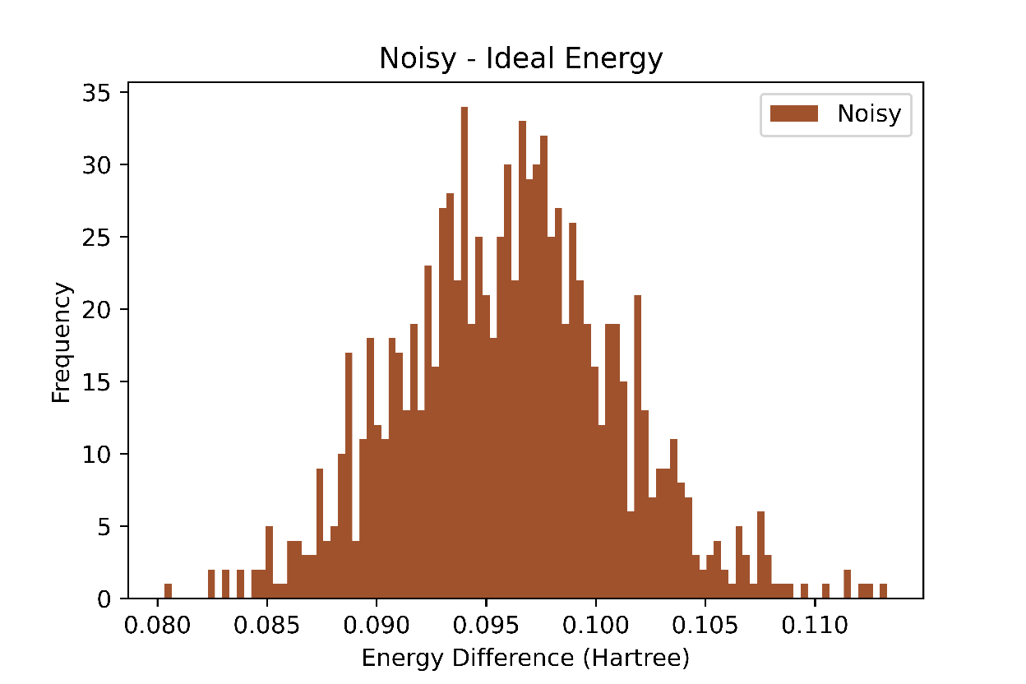
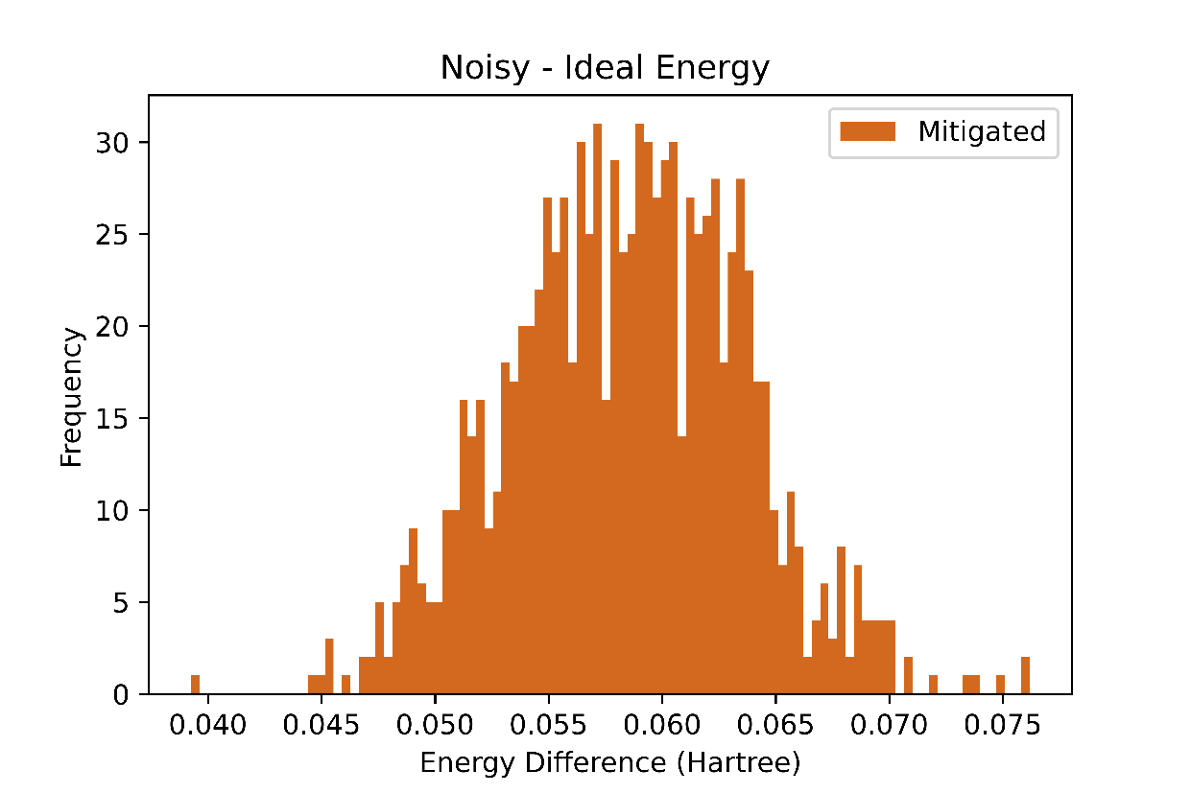
Optimized Parameters [ 0.00172129,-0.00182397, -0.11217598] Full Noise Model

